Slide 1


CSE 860 Generative AI & Applications
Prof. Dr. Yasar Ayaz
(Pride of Performance)
Chairman / Central Project Director
National Center of Artificial Intelligence (NCAI)
Pakistan
Professor & Founding Head
Department of Robotics & AI
NUST-SMME

Slide 2
The Hierarchy of AI: From Machine Learning to Generative AI
Data Science is the processing, analysis and extraction of relevant assumptions from data.
AI is the broad concept of developing machines that can simulate human thinking, reasoning and behaviour.
Artificial Intelligence
Data Science
Machine Learning
Deep Learning
ML is a subset of AI wherein computer systems learn from the environment and, in turn, use these learnings to improve experiences and processes.
GenAI
DL algorithm involves networks with many layers. (Hence the term deep)
It mimics the human brain using artificial neural network, particularly allowing computers to perform complex tasks.
GenAI: A branch of AI focused on creating new data that resembles the input data. Emphasis on generation rather than prediction or classification.

Slide 3
What is Machine Learning
According to Arthur Samuel
Machine learning is a “Field of study that gives computers the ability to learn without being explicitly programmed.”
More formal definition provided by Tom M. Mitchell
A computer program is said to learn from experience E with respect to some class of tasks T and performance measure P if its performance at tasks in T, as measured by P, improves with experience E.
Experience (E): Data or input that the computer program learn from.
Tasks (T): Specific activities or goals that the ML algorithm is designed to perform.
Performance Measure (P): measure of the success or effectiveness of the algorithm wrt the tasks it perform.

Slide 4
What is deep Learning
According to Ian Goodfellow et al.
Deep learning is a subfield of machine learning concerned with algorithms inspired by the structure and function of the brain called artificial neural networks
According to Yann LeCun
Deep learning uses hierarchical layers of neural networks to extract progressively higher-level features from raw input.
Deep learning automatically extracts features from raw data (e.g., image, audio)

Slide 5
What is Generative AI
According to Ian Goodfellow (2014) (creator of GANs)
Generative AI refers to models designed to generate new data samples that resemble the input data distribution, such as images, text, or audio.
According to Andrej Karpathy (2022)
Generative AI builds on large datasets and neural network architectures to create new content, often using transformers and models like GPT

Slide 6
Key Differences
Aspect | Machine Learning | Deep Learning | Generative AI
Focus | Pattern recognition, prediction | Complex feature learning | Content creation
Data Dependency | Moderate | High | High
Key Algorithms | Regression, SVM, etc. | Neural networks (CNNs, RNNs) | GANs, Transformers
Applications | Predictive analytics | Object detection, NLP | Text/image generation

Slide 7
When to use
When to Use Machine Learning (ML):
Best for structured/tabular data with smaller datasets and limited computational resources.
Use for tasks like regression, classification, and clustering where interpretability matters.
When to Use Deep Learning (DL):
Ideal for unstructured data (images, text, audio) with large datasets and high computational power.
Use for complex tasks like image recognition, NLP, and autonomous systems.
When to Use Generative AI (GenAI):
For creating new data (text, images, audio) resembling input data.
Use in creative tasks like content generation, chatbots, or image synthesis.

Slide 8
Machine Learning
There are different types of machine learning we will focus on during the next sections of the course:
Supervised Learning
Unsupervised Learning

Slide 9
Machine Learning Supervised learning
Supervised learning algorithms are trained using labeled examples, such as an input where the desired output is known.
For example, a segment of text could have a category label, such as:
Spam vs. Legitimate Email
Positive vs. Negative Movie Review

Slide 10
Machine Learning Supervised Learning
Supervised learning algorithms are trained using labeled examples, such as an input where the desired output is known.
For example, a segment of text could have a category label, such as:
○Spam vs. Legitimate Email
○Positive vs. Negative Movie Review

Slide 11
Machine Learning
Pipeline
Test
Data
Model Training & Building
Data
Acquisition
Data
Cleaning
Model
Testing
Model
Deployment

Slide 12
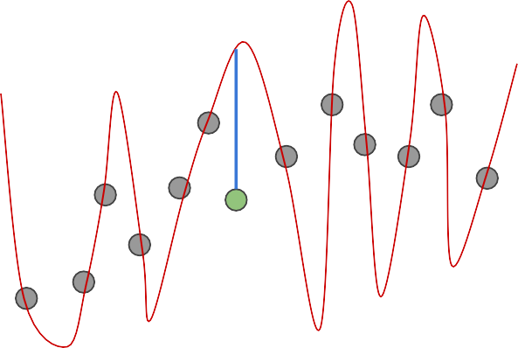
Machine Learning
Overfitting
Underfitting
Good Model
Y
Y
Y
X
X
X
Overfit: Model learns noise, performs well on training but poorly on new data.
Underfit: Model is too simple, fails to capture patterns in data.
Good fit: Model generalizes well, balancing bias and variance.

Slide 13
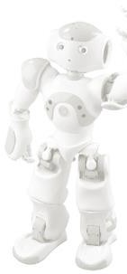
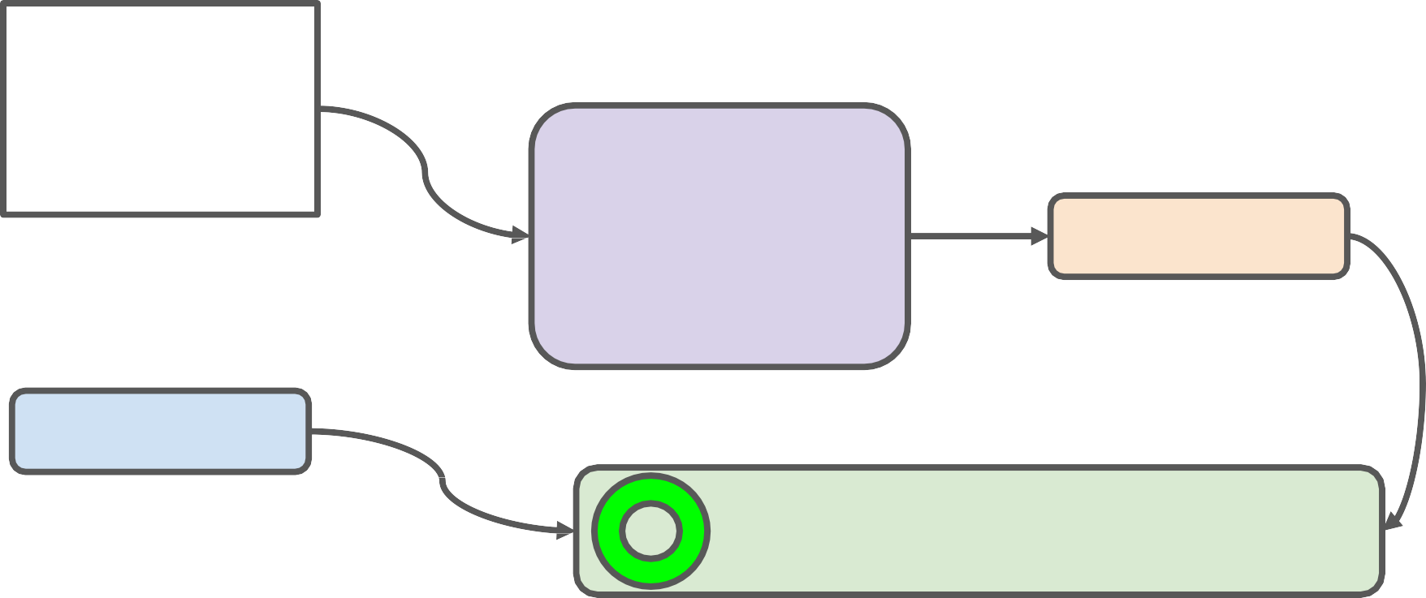
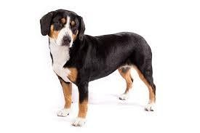

Model Evaluation (classification Problem)
TRAINED MODEL
Test Image
from X_test
DOG
Prediction on
Test Image
DOG
Correct Label
from y_test
DOG == DOG ?
Compare Prediction to Correct Label

Slide 14
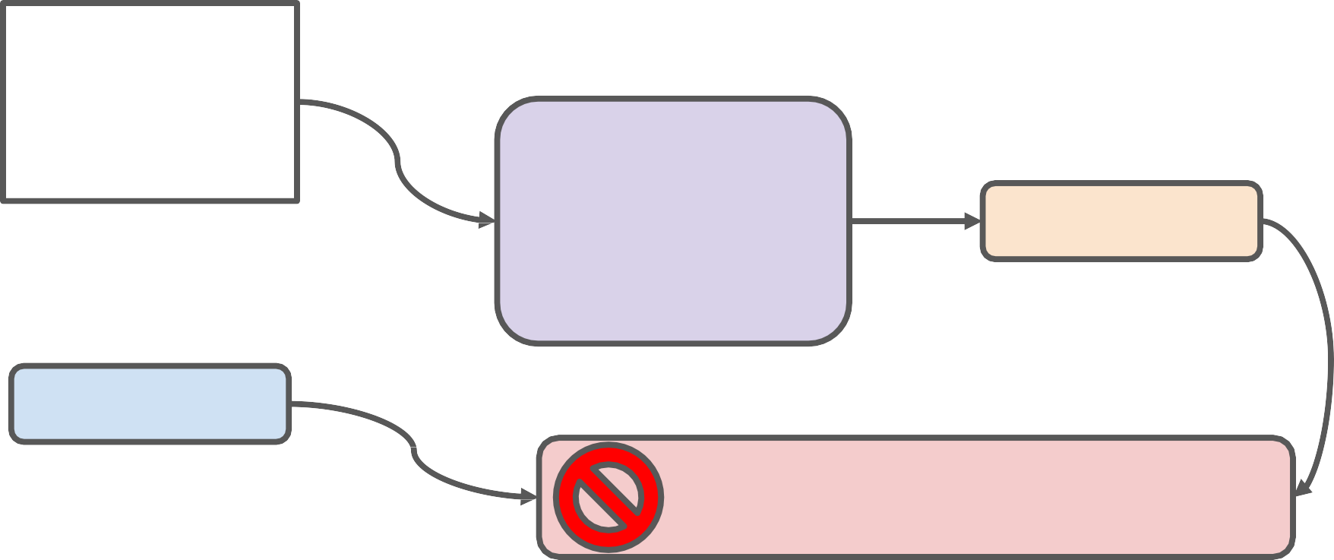
Model Evaluation (classification Problem)
TRAINED MODEL
CAT
Prediction on
Test Image
Test Image
from X_test
DOG
Correct Label
from y_test
DOG == CAT ?
Compare Prediction to Correct Label

Slide 15

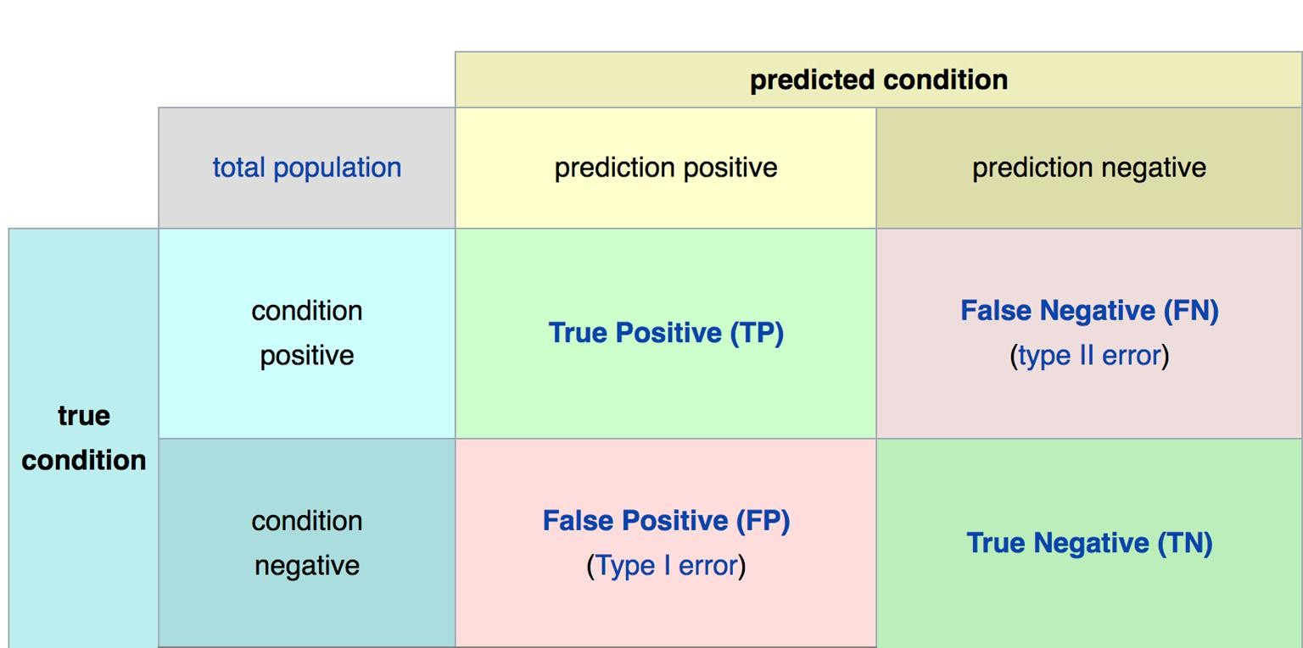
Confusion Matrix
A confusion matrix helps evaluate a classification model by showing actual vs. predicted results, providing insights into errors (false positives/negatives) and performance metrics (accuracy, precision, recall, F1-score). It’s essential for understanding model effectiveness beyond simple accuracy.

Slide 16
Machine Learning (Unsupervised Learning )
Unsupervised learning is a type of machine learning where the model finds patterns and structures in data without labeled outputs.
There are certain tasks that fall under unsupervised learning:
Clustering
Anomaly Detection
Dimensionality Reduction

Slide 17
Deep Learning
Deep learning is a class of machine learning algorithms that uses multiple stacked layers of processing units to learn high-level representations from unstructured data.

Slide 18
Deep Learning
Deep learning can be applied to structured data, but its real power, especially with regard to generative modeling, comes from its ability to work with unstructured data.
Most often, we want to generate unstructured data such as new images or original strings of text, which is why deep learning has had such a profound impact on the field of generative modeling.

Slide 19
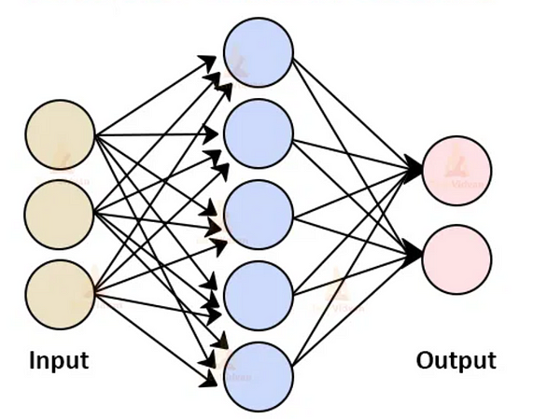
Neural Networks
What is a neural network?
A neural network consists of a series of stacked layers.
Each layer contains units that are connected to the previous layer’s units through a set of weights.

Slide 20
Multilayer Perceptrons (MLPs)
Neural networks where all adjacent layers are fully connected are called multilayer perceptrons (MLPs).
An example of a multilayer perceptron that predicts if a face is smiling

Slide 21
Multilayer Perceptrons (MLPs)
The input (e.g., an image) is transformed by each layer in turn, in a forward pass through the network, until it reaches the output layer.
Each unit applies a nonlinear transformation to a weighted sum of its inputs and passes the output through to the subsequent layer.
An example of a multilayer perceptron that predicts if a face is smiling

Slide 22
Multilayer Perceptrons (MLPs)
The final output layer is the culmination of this process, where the single unit outputs a probability that the original input belongs to a particular category (e.g., smiling).
An example of a multilayer perceptron that predicts if a face is smiling

Slide 23
Multilayer Perceptrons (MLPs)
Deep neural networks find the set of weights for each layer that results in the most accurate predictions.
The process of finding these weights is called training the network.
An example of a multilayer perceptron that predicts if a face is smiling

Slide 24
Multilayer Perceptrons (MLPs)
Weight Upgradation: The error in the prediction is then propagated backward through the network, adjusting each set of weights a small amount in the direction that improves the prediction most significantly.
An example of a multilayer perceptron that predicts if a face is smiling

Slide 25
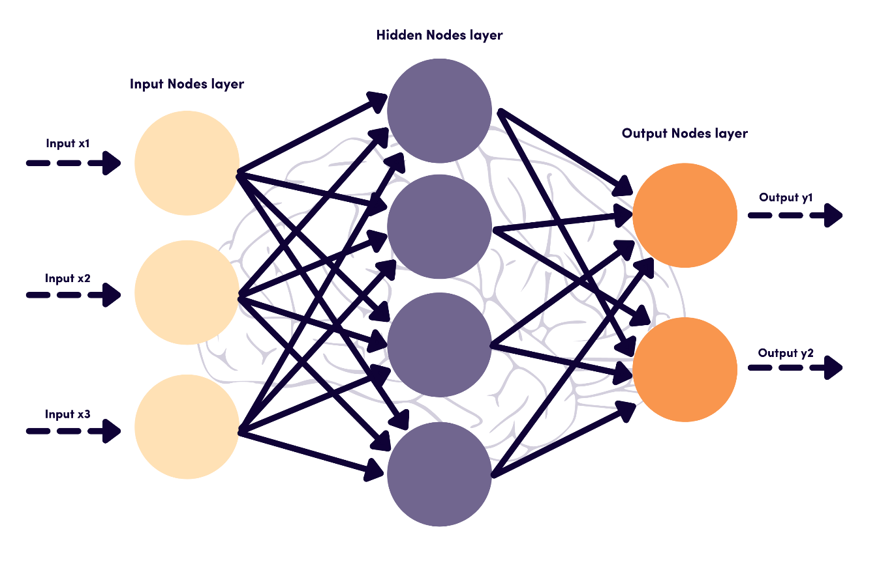
Artificial Neural Network (ANN)
ANNs are the simplest form of neural networks, consisting of layers of interconnected neurons that process and transmit information.
Applications:
Basic image recognition
Simple pattern recognition
Regression tasks

Slide 26
Artificial Neural Network (ANN)
Advantages:
Easy to implement and understand.
Suitable for a wide range of problems.
Challenges:
Limited in handling complex data structures.
Performance depends on the number of hidden layers and neurons.
Artificial Neural Networks (ANNs) are a broad category of neural networks, while Multi-Layer Perceptrons (MLPs) are a specific type of ANN with fully connected layers and no cycles.

Slide 27
Convolutional Neural Network (CNN)
CNNs are specialized neural networks designed for processing structured grid data like images. They use convolutional layers to detect features.

Slide 28
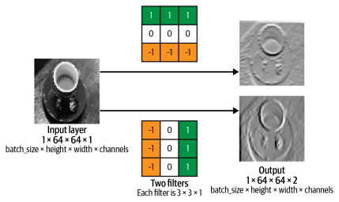
Convolutional Layer
A convolutional layer is simply a collection of filters, where the values stored in the filters are the weights that are learned by the neural network through training. Initially these are random, but gradually the filters adapt their weights to start picking out interesting features such as edges or particular color combinations.
Two convolutional filters applied to a grey scale image.

Slide 29
Convolutional Neural Network (CNN)
Applications:
Image and video recognition
Object detection
Image classification
Advantages:
Excellent at handling spatial data.
Requires less preprocessing compared to ANNs.
Challenges:
Computationally intensive.
Requires large amounts of labeled data for training.

Slide 30
Long Short-Term Memory Network (LSTM)
An LSTM is a particular type of recurrent neural network (RNN). RNNs contain a recurrent layer (or cell) that is able to handle sequential data by making its own output at a particular timestep form part of the input to the next timestep.

Slide 31
LSTM
Applications:
Long-term time series prediction
Advanced NLP tasks (e.g., machine translation)
Speech synthesis
Advantages:
Overcomes the vanishing gradient problem.
Effective at capturing long-term dependencies.
Challenges:
More complex and computationally intensive than standard RNNs.
Requires careful tuning of hyperparameters.

Slide 32
Key Differences Between ANN, CNN, RNN, and LSTM
Data Type:
ANN: General-purpose, works with a variety of data types.
CNN: Best suited for spatial data (e.g., images).
RNN: Designed for sequential data (e.g., time series, text).
LSTM: Enhanced version of RNN, handles long-term dependencies in sequential data.

Slide 33
Key Differences Between ANN, CNN, RNN, and LSTM
Architecture Complexity:
ANN: Simple, fully connected layers.
CNN: Convolutional and pooling layers, followed by fully connected layers.
RNN: Recurrent connections, simple architecture.
LSTM: Complex architecture with memory cells and gates.

Slide 34
Key Differences Between ANN, CNN, RNN, and LSTM
Learning Capabilities:
ANN: Limited in handling complex data structures.
CNN: Excels at detecting spatial hierarchies.
RNN: Good for short-term dependencies.
LSTM: Superior for long-term dependencies.

Slide 35
Key Differences Between ANN, CNN, RNN, and LSTM
Training Challenges:
ANN: Overfitting and underfitting issues.
CNN: High computational requirements.
RNN: Vanishing gradient problem.
LSTM: Complexity and computational intensity.

